Slide 1
Content Analysis
Chapter Twenty

Slide 2
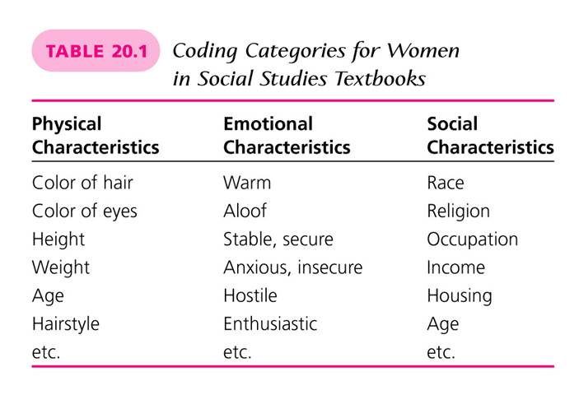
Content Analysis
Chapter Twenty

Slide 3
What is Content Analysis?
Content Analysis is a technique that enables researchers to study human behavior in an indirect way, through an analysis of our communications.
Types of communications are:
    Textbooks
    Essays
    Pictures
    Songs
A person or group’s conscious and unconscious beliefs, attitudes, or values are often revealed in their communication.

Slide 4
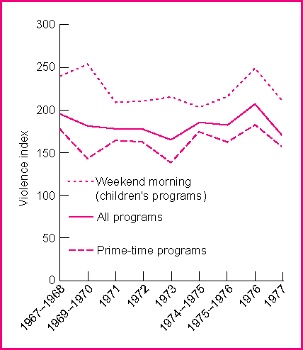
Example of Content Analysis
(Figure 20.1)

Slide 5
Applications of Content Analysis in Educational Research
Describe trends in schooling over time
Understand organizational patterns
Show how different schools handle the same phenomena differently
Infer attitudes, values, and cultural patterns in different countries
Compare the myths that people hold about schools
Gain a sense of how teachers feel about their work
Gain some idea of how schools are perceived
Also, can be used to supplement more direct methods of research

Slide 6
Categorization in Content Analysis
All procedures at some point convert the descriptive information into categories.
There are two ways this might be done
    The researcher determines the categories before any analysis begins. These categories are based on previous knowledge, theory, and experience.
    The researcher becomes very familiar with the descriptive information collected and allows the categories to emerge as the analysis continues.
See p. 488 for an example of this

Slide 7
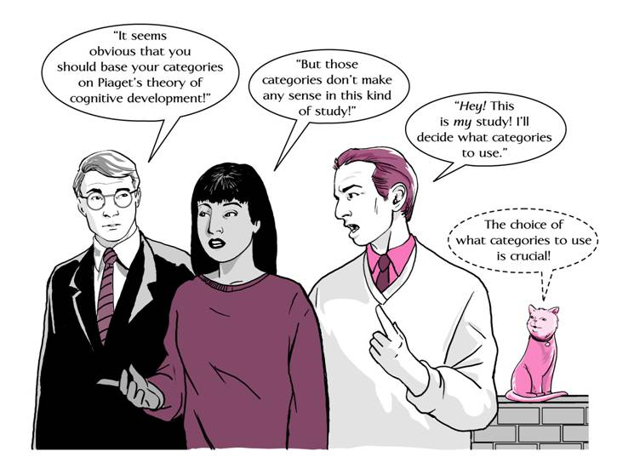
What Categories Should I Use? (Figure 20.2)

Slide 8
Steps Involved in Content Analysis
Determine objectives by obtaining information on the following:
      Formulate themes for organization
      Check other research findings for validation
      Obtain information useful in dealing with educational problems
      Investigate possible relationships to test hypothesis
Define Terms
      Clearly define terms before or during the study
Specify the Unit of Analysis

Slide 9
Steps Involved in Content Analysis
(cont.)
Locate Relevant Data
Develop a Rationale
    Conceptual link needed to relate data to the objectives
Develop a Sampling Plan
    Techniques could involve:
        Random sample
        Stratified sampling
        Cluster sampling
Formulate Coding Categories (Table 20.1)

Slide 10
(Table 20.1)

Slide 11
Steps Involved in Content Analysis
(cont.)
Checking Reliability and Validity
    Test-retest method
    Check manifest against latent content
Analyze Data
    Counting
    Record the base
    Use descriptive statistical procedures such as frequencies and/or percentages

Slide 12
Sample Tally Sheet (Table 20.2)
Number Number Number
Newspaper of Editorials Subjective of Pro-Abortion of Anti-Abortion
ID Number Location Circulation Coded Evaluationª Editorials Editorials
101 A 3,000,000 29 3 0 1
102 B 675,000 21 3 1 1
103 C 425,000 33 4 2 0
104 D 1,000,000 40 1 0 8
105 E 550,000 34 5 7 0
ªCategories within the subjective evaluation: 1 = very conservative; 2 = somewhat conservative; 3 = middle-of-the-road; 4 = moderately liberal; 5 = very liberal.

Slide 13
Advantages of Content Analysis
The following are considered advantages of Content Analysis:
  Unobtrusive
  Useful means of analyzing interview and observational data
  Not limited by time and space to the study of present events
  Relatively simple and economical with regard to both time and resources, compared to other forms of research methods

Slide 14
Disadvantages of Content Analysis
The following are considered disadvantages of Content Analysis:
  Usually limited to recorded information
  Establishing validity
    Question remains as to the true meaning of the categories themselves
  Historical research findings might not be considered important today
  Temptation to attribute a cause of a phenomenon vs. a reflection of it

Slide 15
Analysis of the Study
Purpose
Definitions
Prior Research
Hypothesis
Sample
Instrumentation and Data Analysis
Internal Validity
Results and Discussion

